Slide 1
Comp257 Data Science Project Group D
Simon Chalmers
Mitchell Whyte
Jack Moore

Slide 2
Our Problem Statement: Are we able to predict the ratio of likes to dislikes on YouTube videos using data obtained from the YouTube API?

Slide 3
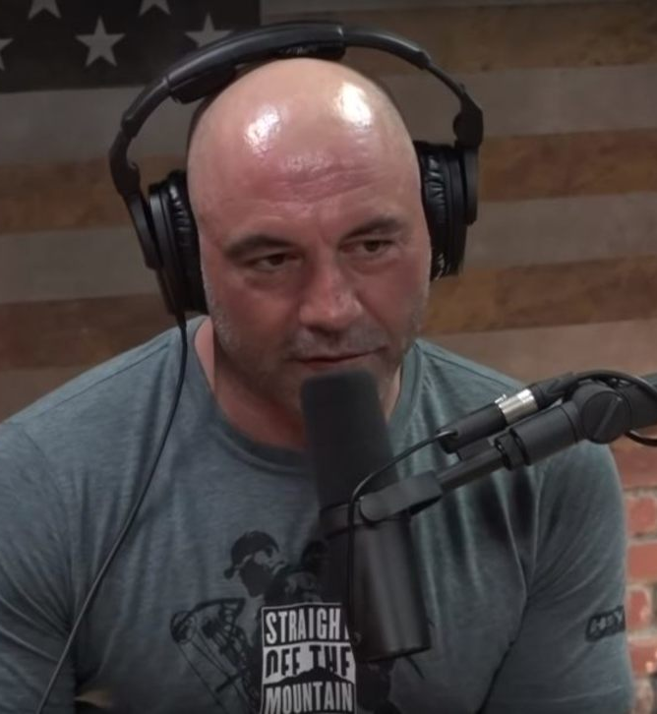
An Introduction to our Project
The Joe Rogan Experience is an extremely popular podcast that hosts a variety of different guests.
Why The Joe Rogan Experience?
Wide variety of guests
Uniformity of data
Very popular popcast which we knew would have lots of views, likes, dislikes and comments
Initially thought about classifying guest type but chose to go another path
We chose to use the Joe Rogan Experience Channel
As a vessel for answering our problem statement

Slide 4



We wanted to know if we could create a model that could predict this:

Slide 5
Our Data:
Our data was collected from the YouTube data API.
We chose to analyse Joe rogan experience videos.
We queried the API for the statistics, dates and comments for each episode of the Joe Rogan Experience.
The comments were then processed through NLP to apply sentiment analysis for each individual comment.
The sentiment analysis used a 'Bag of Words' model to evaluate the sentiment of each comment. Each comment was given a numbered label corresponding to which video the comment belonged.
1393 videos
3.5million comments

Slide 6
Youtube video statistical features:
viewCount
commentCount
likeCount
dislikeCount
ratio
ratio_bins
Sentiment analysis features:
Descriptive statistics for magnitude and sentiment score
Other features:
Date
Class (guest type)
22 features in total

Slide 7
How we did our sentiment word analysis
We used NLP
Each comment is treated as a document and is then broken down into a bag of words. Each word in the comment is then tokenized using the spaCy python library. Each word is lemmatised to get the root meaning of the word. A lexicon of 155,000 words with sentiments scores attached to them were obtained free from SentiWords.
After processing a comment, each word in the bag of words has been given a sentiment score, and the total sentiment score is average of these sentiments. The total magnitude is added up as well from the sentiment of each word, but is not normalised.
After the comments were processed, the sentiment scores and magnitudes were grouped by the video they belonged to. We took the descriptive statistics of the grouped comments for each video and joined it to our data Frame, along with the other columns of our YouTube video data Frame.

Slide 8
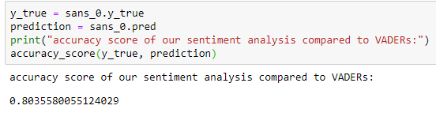
Testing our sentiment analysis
To test our sentiment analysis we obtained an already labeled dataset to compare our sentiment scores with.
4200 tweets with sentiment scores attached to each tweet
The data set was obtained from VADER, a sentiment analysis module created by researchers at the Georgia Institute of Technology
We turned out floating point sentiment scores into -1, 0 and 1, and applied the same to the vade dataset
Our sentiment analysis performed at roughly 80%

Slide 9
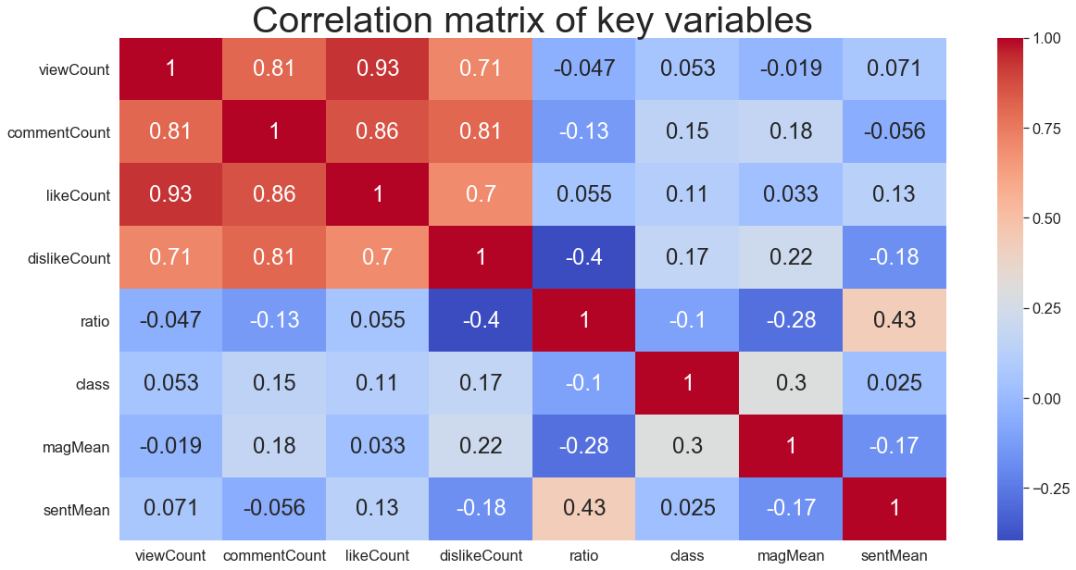
Key Variables
We found that all of the YouTube features such as likeCount and commentCount were determined by the viewCount

Slide 10
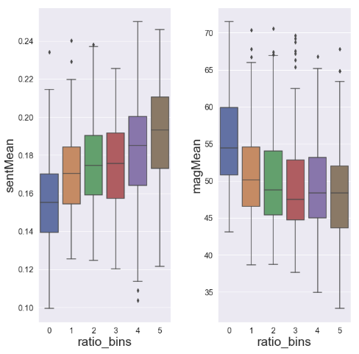
Univariate Analysis
We used boxplots to visualize all of our key parameters at once, compared with ratio_bins
We are able to see that low ratio videos actually had higher magnitude

Slide 11
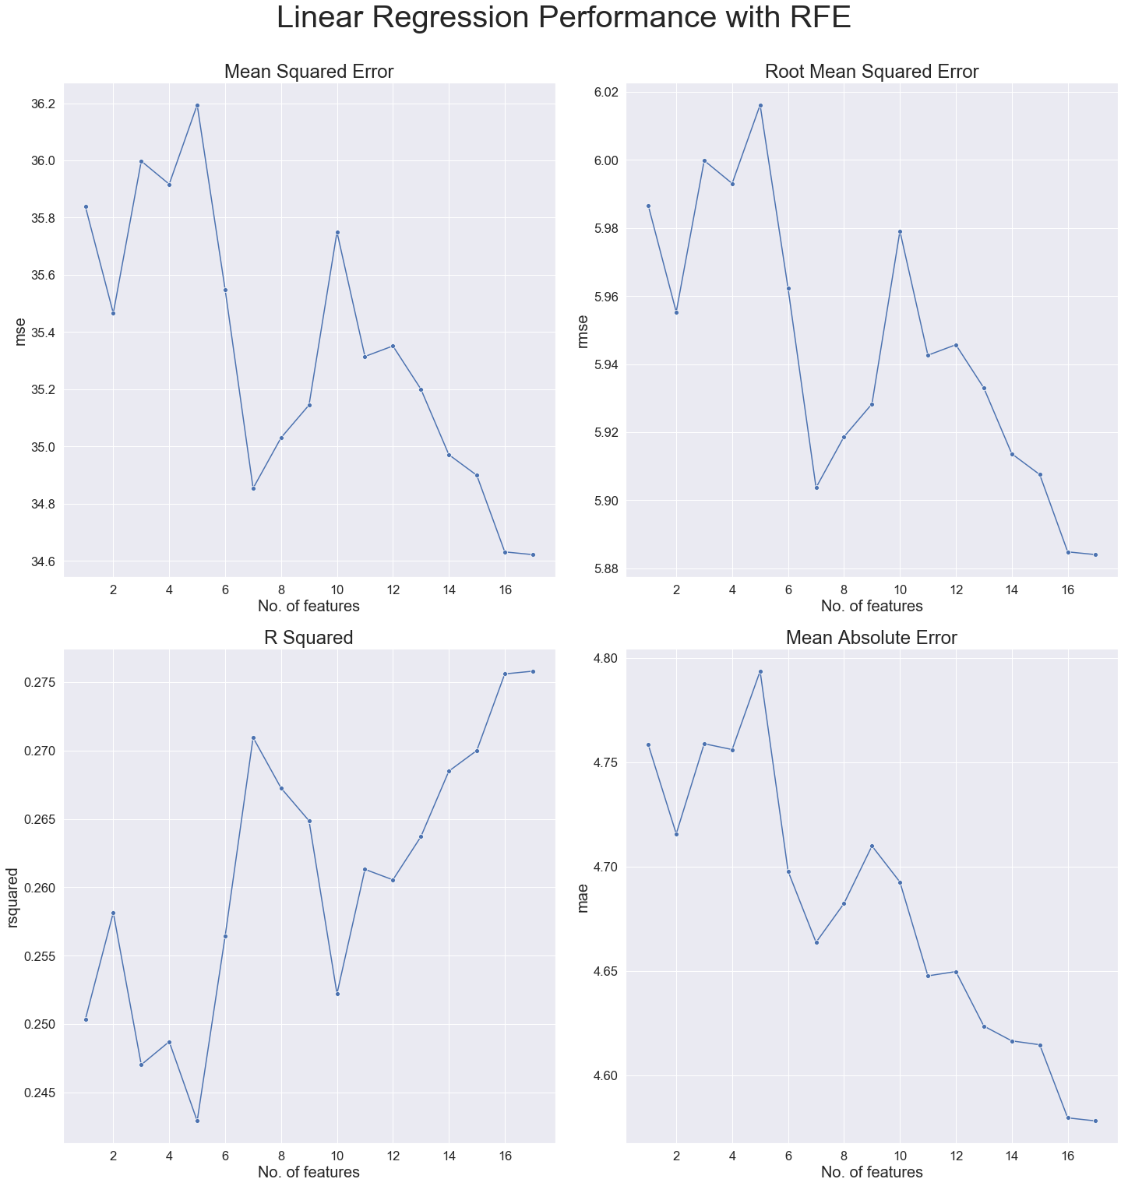
Linear Regression
For our linear regression model, we used linear regression along with recursive feature elimination for our prediction.
We concluded that the linear regression performs the best with all of the features included.

Slide 12
Logistic Regression Best Performing Features
features | ranking
14 | sentUq | 1
4 | sentMean | 2
12 | sentMedian | 3
8 | sentMin | 4
10 | sentLq | 5
16 | sentMax | 6
7 | magMin | 7
6 | sentStd | 8
9 | magLq | 9
3 | magMean | 10
11 | magMedian | 11
5 | magStd | 12
13 | magUq | 13
0 | class | 14
15 | magMax | 15
2 | commentCount | 16
1 | viewCount | 17

Slide 13
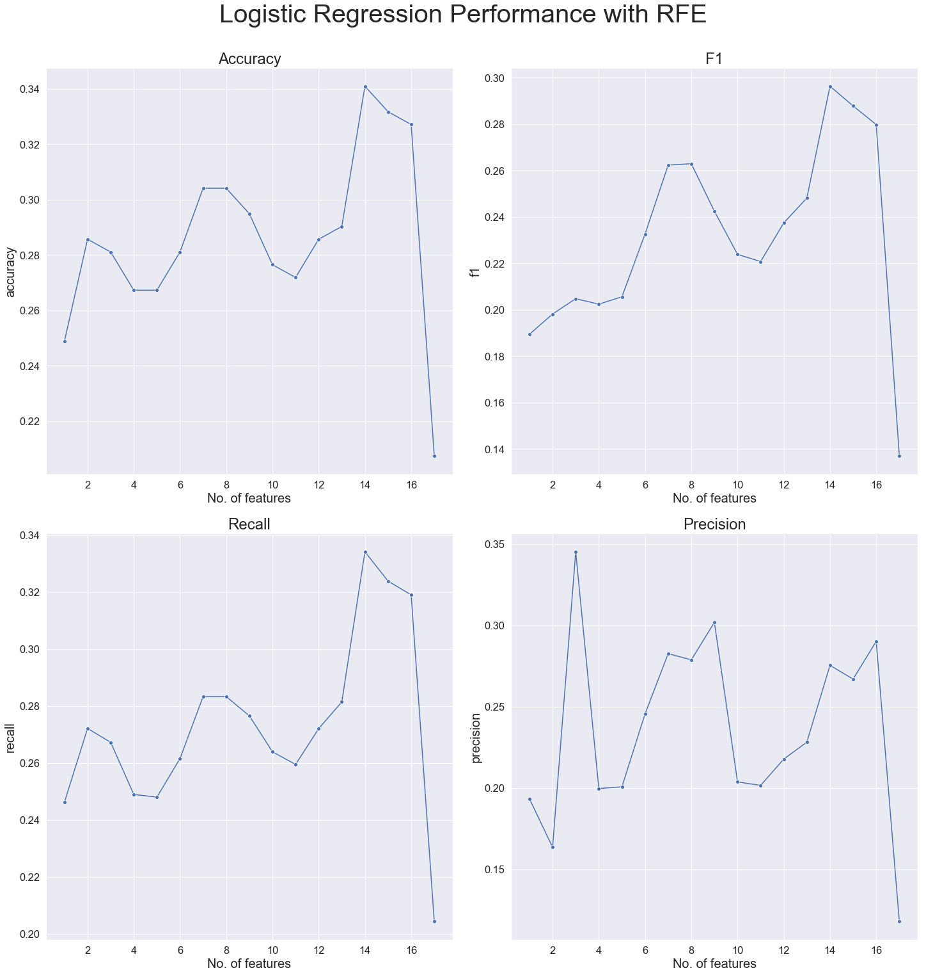
Logistic Regression
For our logistic regression model, we used Logistic Regression along with Recursive Feature Elimination again.

Slide 14
Linear Regression Best Performing Features
features | ranking
6 | sentMean | 1
8 | sentStd | 2
14 | sentMedian | 3
12 | sentLq | 4
16 | sentUq | 5
10 | sentMin | 6
18 | sentMax | 7
9 | magMin | 8
7 | magStd | 9
13 | magMedian | 10
5 | magMean | 11
15 | magUq | 12
11 | magLq | 13
0 | class | 14
17 | magMax | 15
4 | dislikeCount | 16
2 | commentCount | 17
3 | likeCount | 18
1 | viewCount | 19

Slide 15
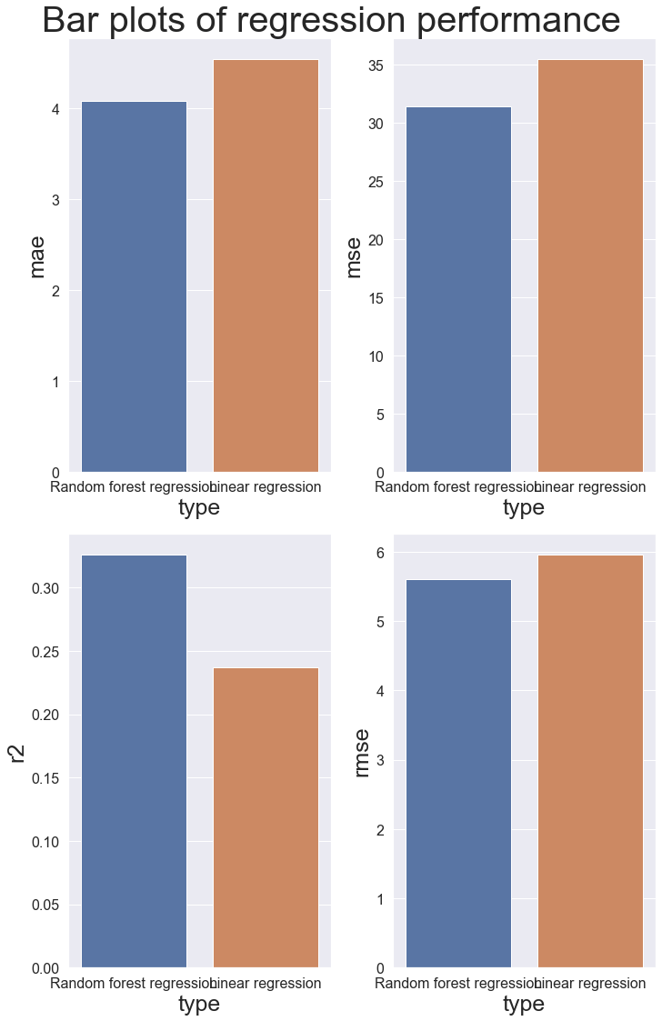
Improved Model: Linear Regression Random Forest Regressor

Slide 16
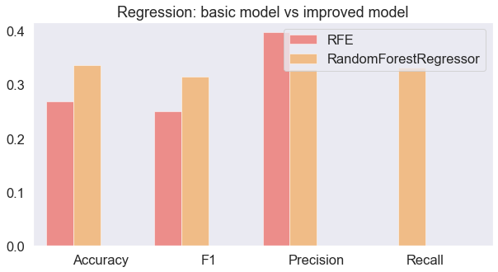
Regression: Basic Model vs Improved Model

Slide 17
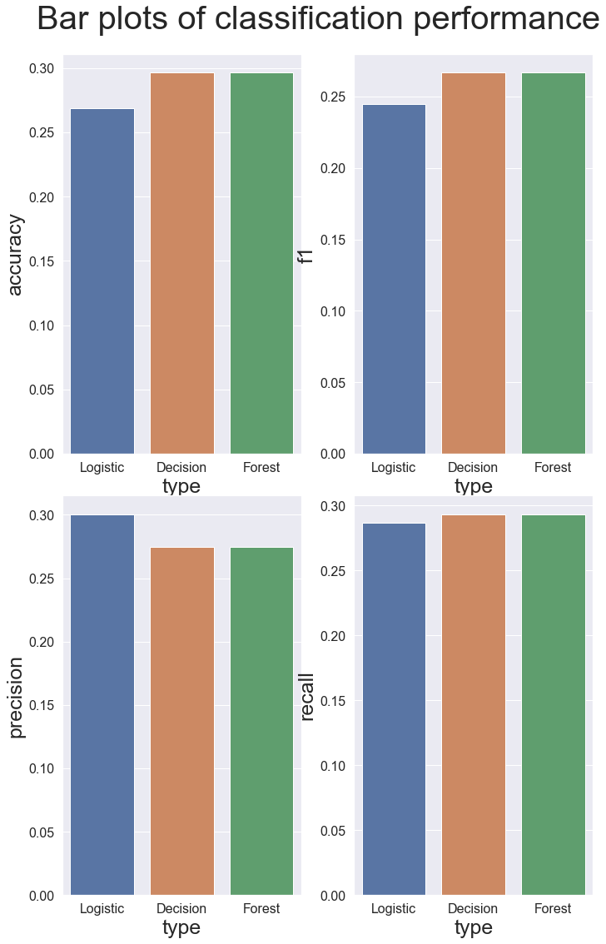
Improved Model: Decision Tree Classifier Random Forest classifier Grid Search CV

Slide 18
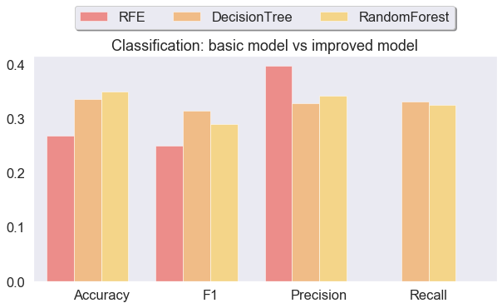
Classification: Basic Model vs Improved Model

Slide 19
Conclusion
The aim of our project was to predict the ratio of like to dislikes using the features of our YouTube data such as comment sentiment on The Joe Rogan Experience podcast.
The conclusion to our research question is that we cannot reliably predict the ratio of likes to dislikes with our current data.

Slide 20
Reflection
We believe that with more robust data we could improve our models to a level in which we could make much more accurate predictions.
One way we could improve our data would be by obtaining videos with a minimum of 50,000 views.
This method of collecting data from YouTube and the comment sentiment analysis is extremely useful and could easily be applied in a future project with a more precise research question.

